Slide 1
BookTech Library Management Team Members: -Omkar Chaudhary - Abdelghani Houbbadi - Soufiane Bannouni - Asjad Anis - Binod Pant

Slide 2
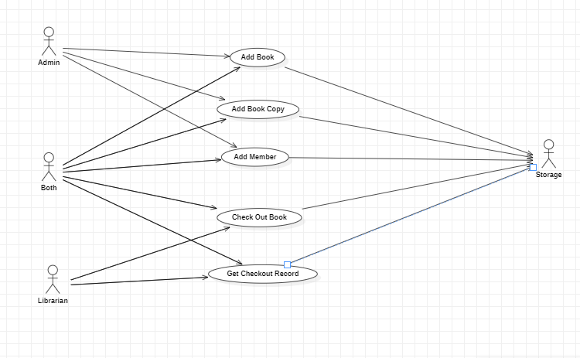
Use Case Diagram

Slide 3
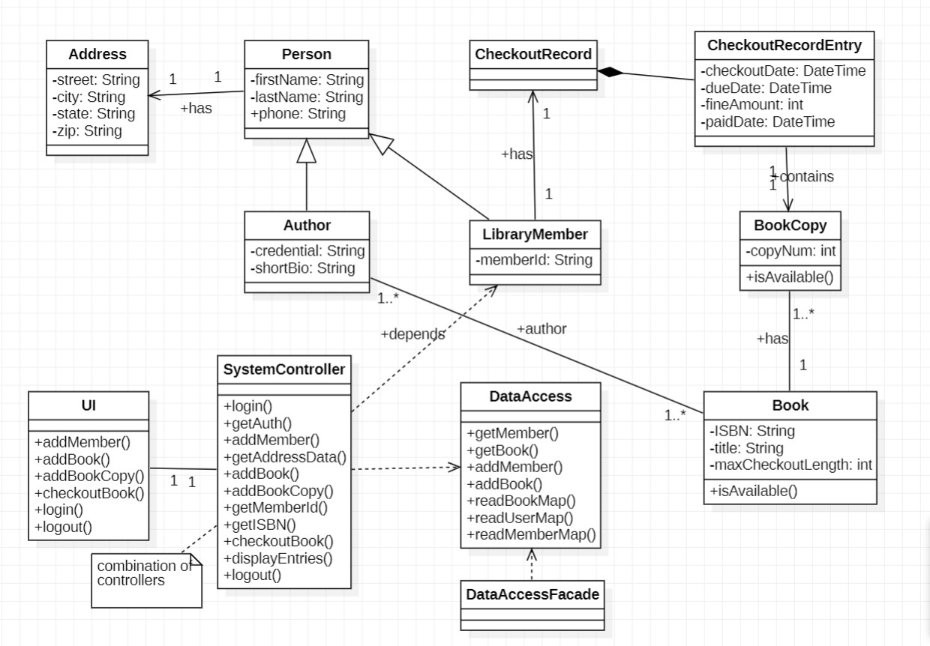

Slide 4
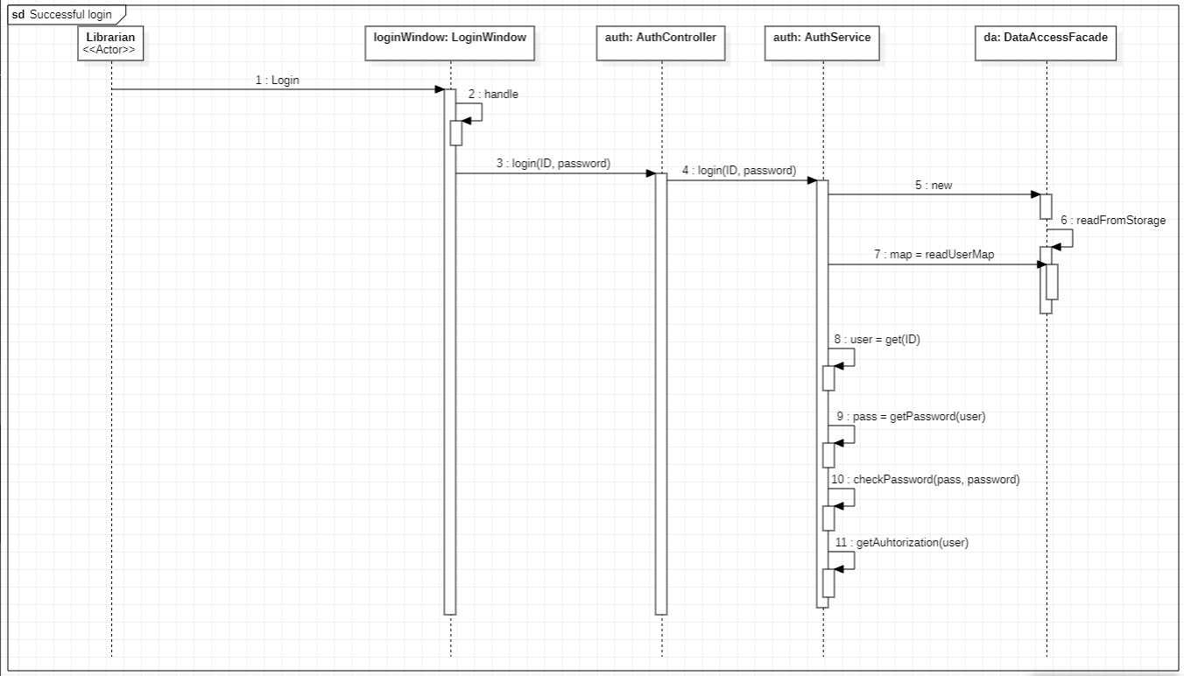

Slide 5
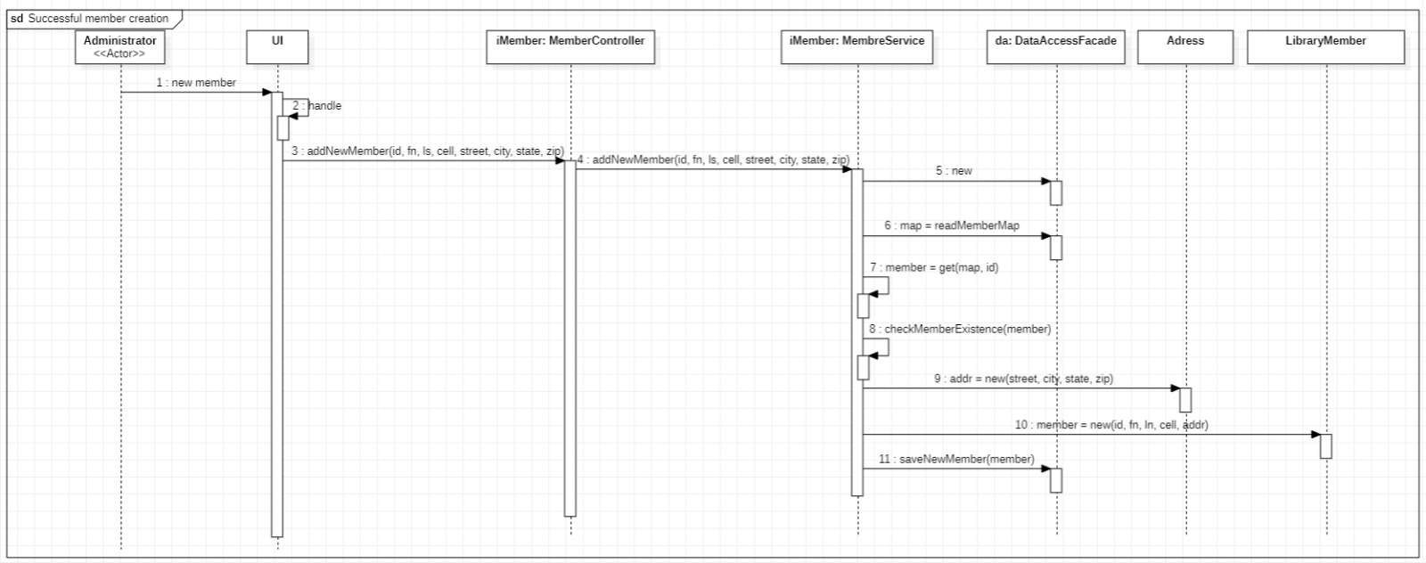

Slide 6
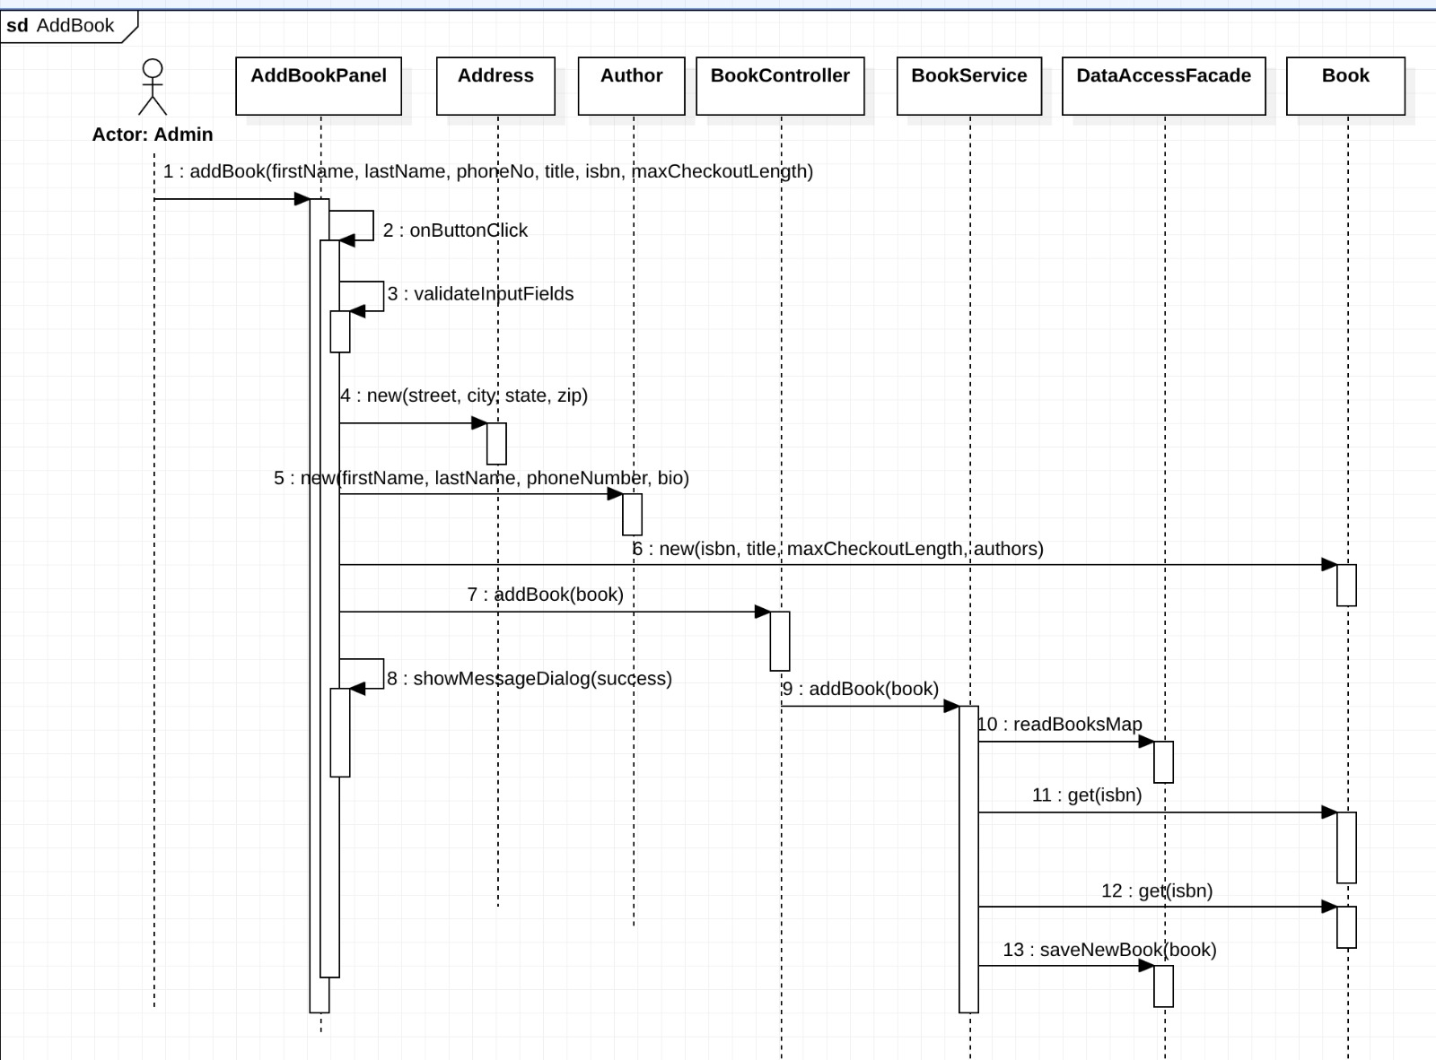

Slide 7
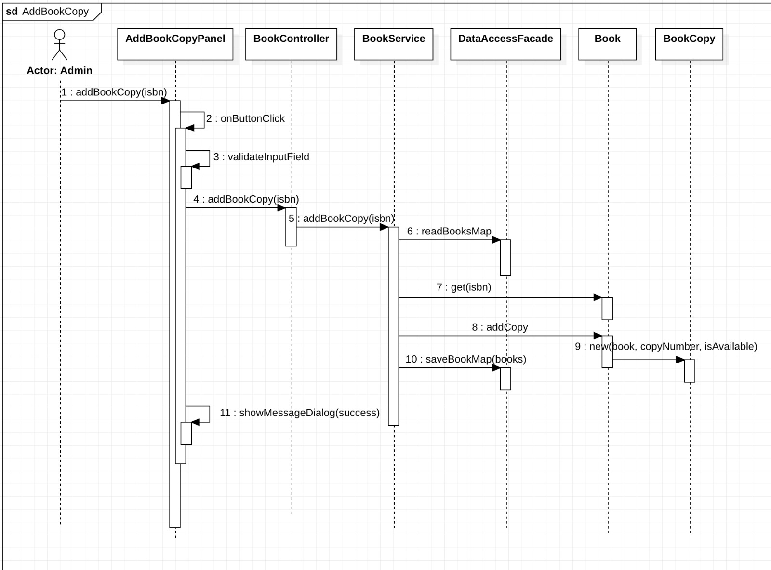

Slide 8
